Slide 1
B2B: 全方位數碼行銷方案
B2B: WebSolutions
Celine Leung
業務拓展及傳訊部經理
Sales and Communications Manager
本簡報中提到的收入等級純屬舉例說明，無意代表美安香港超連鎖™店主的一般收入，也無意表示任何超連鎖™店主皆可賺取同等收入。美安香港超連鎖™店主的成功與否，取決於其在發展事業時的努力、才能與投入程度。The income levels mentioned in the following presentation are for illustration purposes only. They are not intended to represent the income of a typical Market Hong Kong UnFranchise ™Owner, nor are they intended to represent that any given Independent UnFranchise ™ Owner will earn income in that amount. The success of any Market Hong Kong Independent UnFranchise ™ Owner will depend upon the amount of hard work, talent, and dedication which he or she devotes to building his or her Market Hong Kong Business.

Slide 2
[
]
BUSINESS TO BUSINESS
WEBSOLUTIONS I UNFRANCHISE SOLUTIONS

Slide 3
WEBSOLUTIONS
Notes:
TRAINER’S NOTES:
MOST IMPORTANT: “LISTEN FOR” So you can offer a solution to the problem
You can use the B2B Catalog (pictured on the right) to educate a client on how we compare and what we offer with our core solution
Product Specialists can answer further questions on this during an appointment
There are FAQs on mawc411.com and mawebcenters.com

Slide 4
WEB MANAGEMENT
Notes:
TRAINER’S NOTES:
MOST IMPORTANT: “LISTEN FOR” So you can offer a solution to the problem
You can use the B2B Catalog (pictured on the right) to educate a client on how we compare and what we offer with our core solution
Product Specialists can answer further questions on this during an appointment
There are FAQs on mawc411.com and mawebcenters.com

Slide 5
DESIGN OPTIONS
Notes:
TRAINER’S NOTES:
MOST IMPORTANT: “LISTEN FOR” So you can offer a solution to the problem
You can use the B2B Catalog (pictured on the right) to educate a client on how we compare and what we offer with our core solution
Product Specialists can answer further questions on this during an appointment
There are FAQs on mawc411.com and mawebcenters.com

Slide 6
SEO
GOOGLE ADWORDS
FACEBOOK ADS
SOCIAL MEDIA
Notes:
TRAINER’S NOTES:
MOST IMPORTANT: “LISTEN FOR” So you can offer a solution to the problem
You can use the B2B Catalog (pictured on the right) to educate a client on how we compare and what we offer with our core solution
Product Specialists can answer further questions on this during an appointment
There are FAQs on mawc411.com and mawebcenters.com

Slide 7
DO YOU WISH THAT YOU KNEW “JUST THE RIGHT QUESTIONS” TO ASK YOUR PROSPECTS?
QUALITY QUESTIONS= QUALITY PROSPECTS

Slide 8
ASSESSMENT SHEETS AVAILABLE FOR DOWNLOAD SOON!!
Website Design & Management
Social Media
Business Spending
Notes:
TRAINER’S NOTES:
Flyers and catalogs be downloaded at www.mawc411.com
You can print these or email them to prospective WebCenter Owners to peak their interest about our program and products

Slide 9
ASSESSMENT SHEETS AVAILABLE FOR DOWNLOAD SOON!!
Notes:
TRAINER’S NOTES:
Flyers and catalogs be downloaded at www.mawc411.com
You can print these or email them to prospective WebCenter Owners to peak their interest about our program and products

Slide 10
BUSINESS SERVICES: MORE THAN JUST A WEBSITE
Your client buys a website
Item | Retail Profit | BV
WEBSITE SALE | HK$7,700 | 200 BV 30/ MO.
DESIGN PACKAGE |  | 50 BV
SOCIAL MEDIA MANAGEMENT | HK$117/MO. | 20 BV/MO.
PREMIUM FACEBOOK ADVERTISING | HK$79/MO. | 15 BV/MO.
BASIC GOOGLE ADVERTISING | HK$185/MO. | 24 BV/MO.
TOTAL INITIAL SALE | HK$8,081 | 339 BV
TOTAL RECURRING | HK$381/ MO. | 89 BV/ MO.
Then wants to market the site
Notes:
TRAINER’S NOTES:
Take a look at what the Digital Marketing Products generate
Remember, full pricing and BV is available on mawc411.com/support.html

Slide 11
B2B: 全方位數碼行銷方案
B2B: WebSolutions
Maggie Su
主管經理級
Master Coordinator
四個佣金週期共賺取HK$16,100
HK$16,100 in 4 Commission weeks
本簡報中提到的收入等級純屬舉例說明，無意代表美安香港超連鎖™店主的一般收入，也無意表示任何超連鎖™店主皆可賺取同等收入。美安香港超連鎖™店主的成功與否，取決於其在發展事業時的努力、才能與投入程度。The income levels mentioned in the following presentation are for illustration purposes only. They are not intended to represent the income of a typical Market Hong Kong UnFranchise ™Owner, nor are they intended to represent that any given Independent UnFranchise ™ Owner will earn income in that amount. The success of any Market Hong Kong Independent UnFranchise ™ Owner will depend upon the amount of hard work, talent, and dedication which he or she devotes to building his or her Market Hong Kong Business.

Slide 12
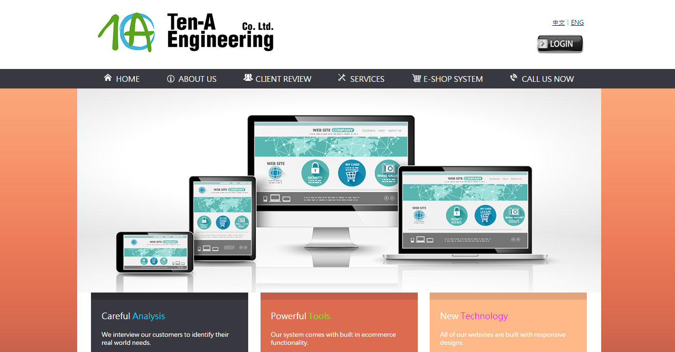

Slide 13
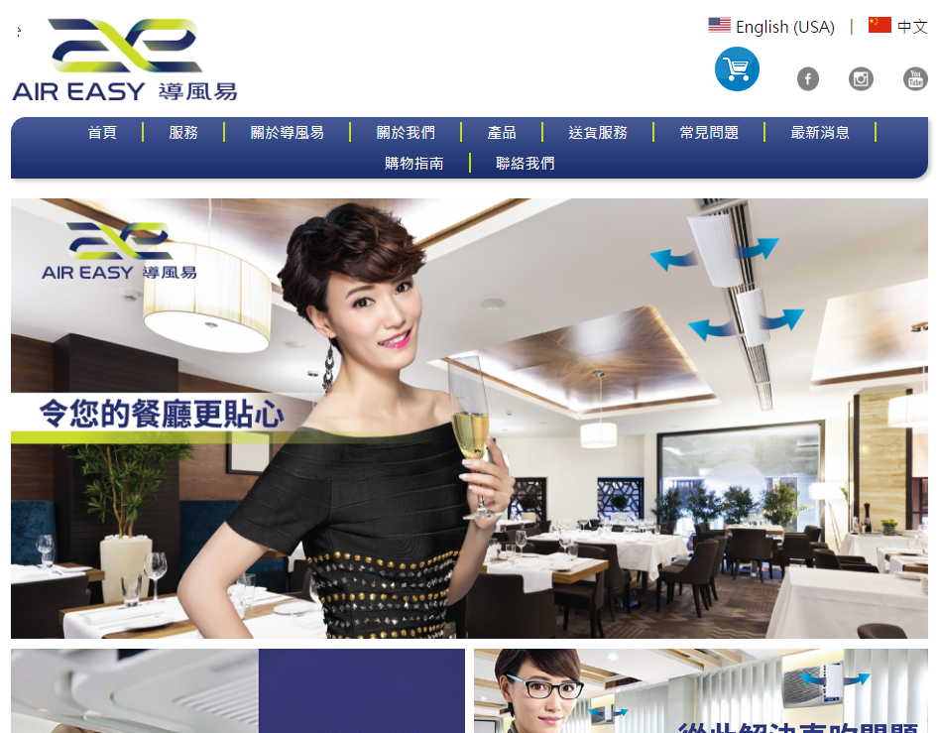

Slide 16
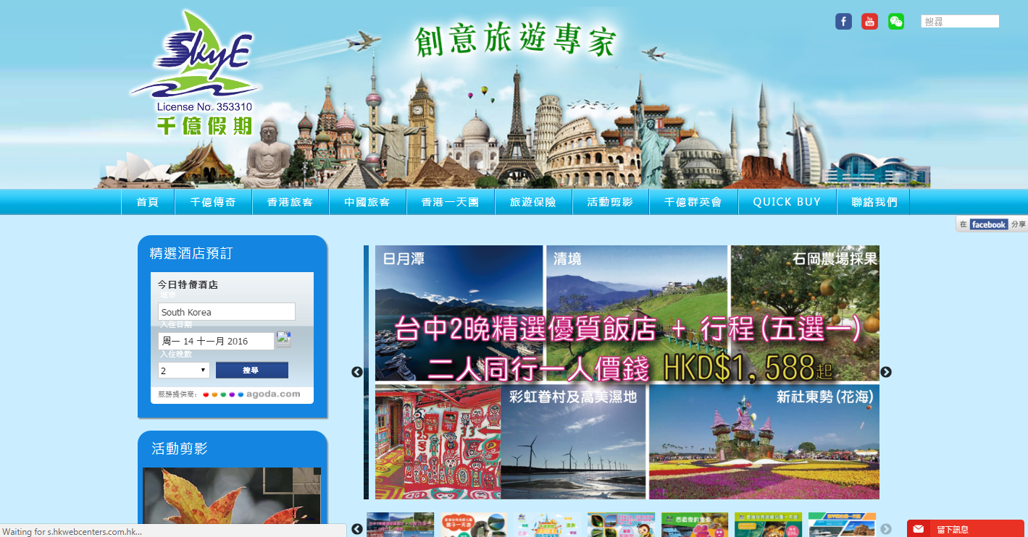

Slide 17
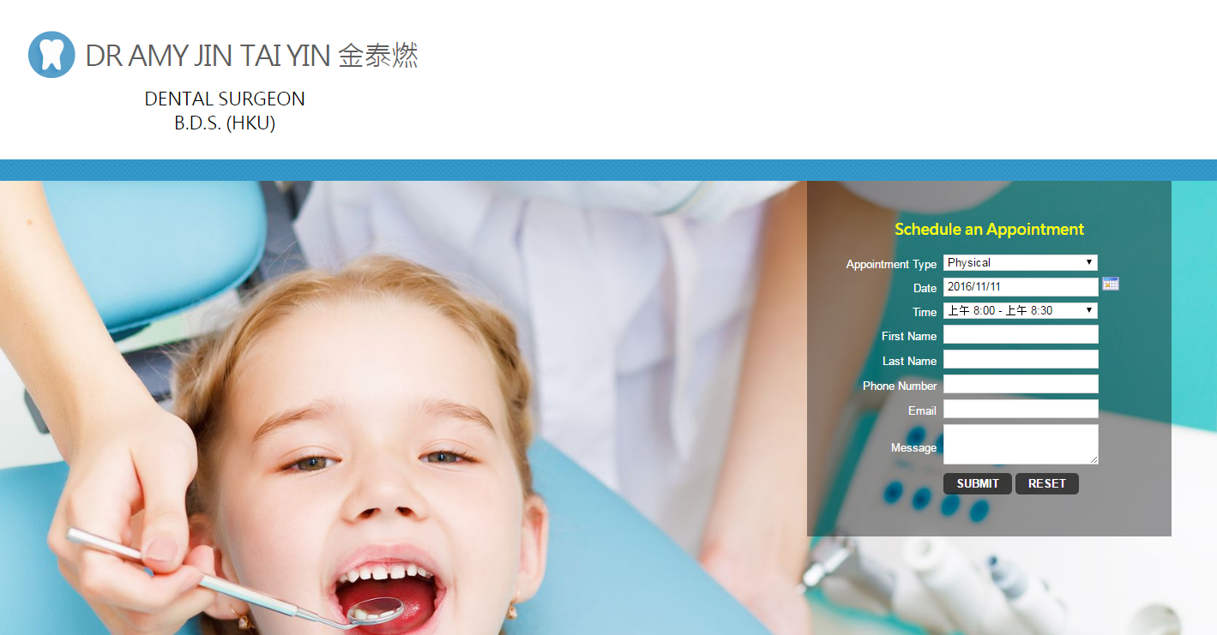

Slide 18
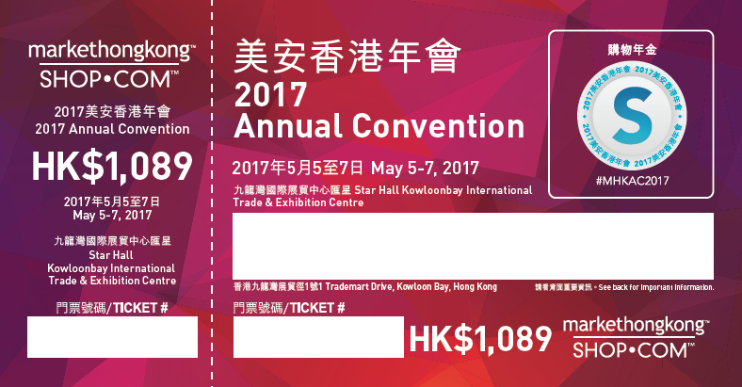
Get your tickets to 2017 Annual Convention NOW!
Date: May 5 – 7, 2017
Venue: Star Hall, Kowloonbay International Trade & Exhibition Centre
Ticket price: $1,089
One FREE
WebCenter
This weekend ONLY!
Get three tickets in a single order, and you will receive:
One free bottle of Isotonix OPC-3
One Lumiere de Vie Volcanic Exfoliating Mask
One free WebCenter
Plus, two ticekts to special sharing by our renowned leaders! Tickets are limited!

